Slide 1
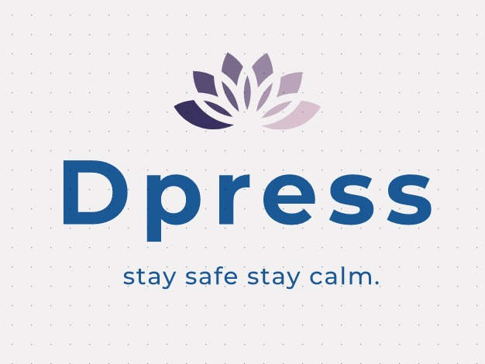
HEALTHTECH APP
H E
A L
T H
T E
C H

Slide 2
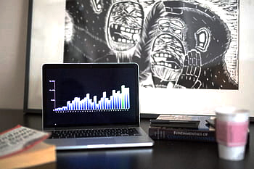
OVERVIEW
Depression is a mood disorder that involves a persistent feeling of sadness and loss of interest. It is different from the mood fluctuations that people regularly experience as a part of life.
Depression is treatable, and managing symptoms usually involves three components:
Support
Psychotherapy
Drug treatment
Medication
Antidepressants

Slide 3
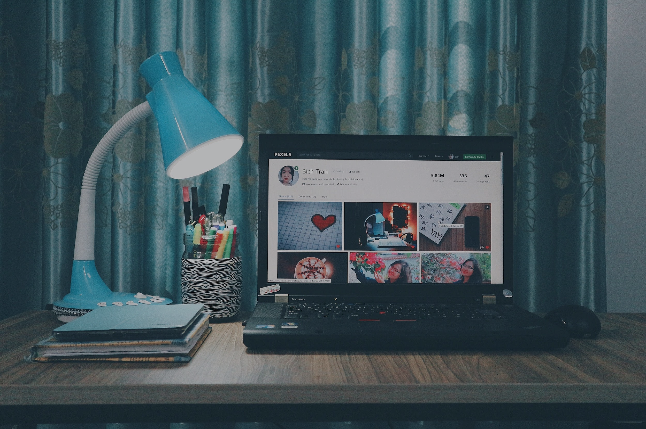


A P P L I C A T I O N INVOLVES
JOURNAL
HELP
INPUT EMOTICON
CHOOSE EMOTICON ACCORDING TO YOUR MOOD.
INPUT ONE OF THE NINE REASONS.
RECORD
GIVES HISTORY OF YOUR INPUTS.
GIVES GRAPHICAL ANALYSIS FOR BETTER TRACK.
SOOTHING MUSIC
BREATHING EXERCISE

Slide 4





STRATEGY
Gives you long term plan to deal with the situation.
MOTIVATION
Gives Motivational Quotes.
INFORMATION
Gives information about various mental health issues.
DOCTOR
Suggests the list of doctor in your locality.

Slide 5
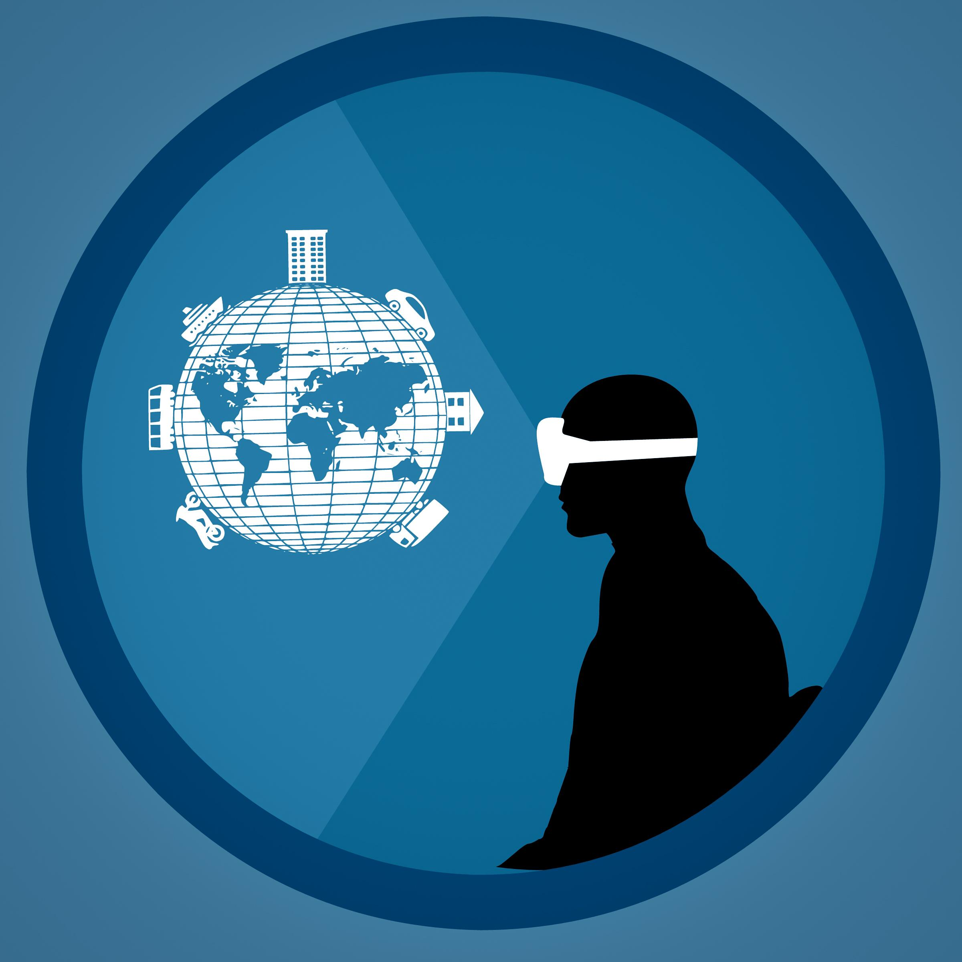
FUTURE DEVELOPMENTS
Planed to add AI system for better recognition of mental health issues by constant monitoring via. user input.
Add an instant chat/call feature with therapist.
Add audio clips to make therapy sessions more helpful.

Slide 6

REVENUE MODEL
FOR 1ST WEEK COMPLETE APP CAN BE USED. THEREAFTER CHOICE WILL BE PROVIDED BETWEEN FREE VERSION AND PREMIUM VERSION.
PREMIUM SUBSCRIPTION WILL BE PROVIDED AT NORMAL CHARGES ON MONTHLY BASIS.

